Slide 1


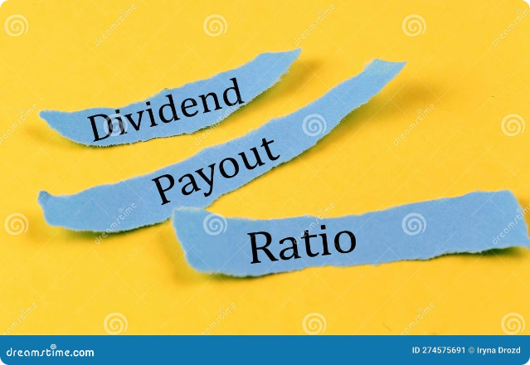
Dividend Policy: A Comprehensive Overview
Dividend policy plays a critical role in corporate finance, influencing shareholder value and company growth. It refers to the guidelines and strategies companies use for distributing profits to shareholders.
by Anoop Mohanty
AM

Slide 2


Residual Dividend Policy
The residual dividend policy prioritizes reinvesting profits back into the business for growth opportunities. Dividends are only paid out after all profitable investment projects have been funded.
Advantages
Disadvantages
Maximizes investment opportunities and potential for long-term growth.
Can lead to unstable and unpredictable dividend payouts for shareholders, which may not be desirable.

Slide 3


Stable Dividend Policy
A stable dividend policy focuses on maintaining consistent dividend payouts over time, even if profits fluctuate.
Regular Payouts
Investor Satisfaction
Provides predictable income for shareholders, enhancing investor confidence.
Regular dividends attract and retain investors, contributing to a stable shareholder base.
1
2
3
Consistent Growth
Gradual increases in dividends over time signal company stability and growth potential.

Slide 4
Constant Payout Ratio Dividend Policy
A constant payout ratio policy aims to distribute a fixed percentage of earnings as dividends each year.
Benefits
Drawbacks
Simplicity and predictability for shareholders, as they can easily estimate future dividend income.
Can lead to unstable dividends if profits fluctuate significantly, potentially impacting shareholder expectations.

Slide 5

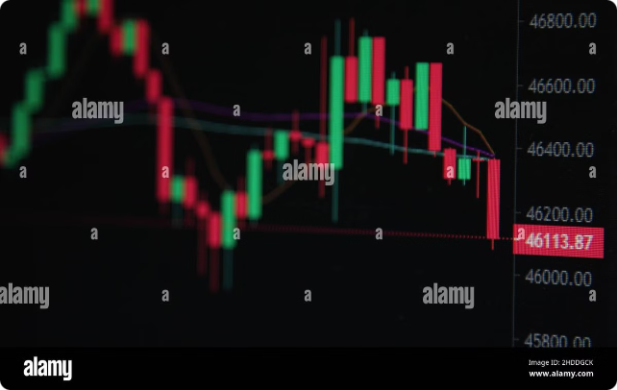
Irregular Dividend Policy
An irregular dividend policy allows for varying dividend payouts based on factors such as company performance, market conditions, and investment opportunities.
1
Flexibility
2
Uncertainty
Enables companies to adjust dividends to changing circumstances, maximizing shareholder returns.
Can lead to unpredictable dividend payouts, which may make it challenging for shareholders to plan.
3
Investor Sentiment
May cause fluctuations in investor confidence and stock price, especially if dividends are reduced unexpectedly.

Slide 6


Liquidating Dividend Policy
A liquidating dividend policy involves distributing profits to shareholders as part of a company's winding down or liquidation process.
Type
Description
Final Dividend
Paid out after the company's assets have been sold and liabilities settled.
Partial Liquidation
Distributed when a company decides to sell off a portion of its assets.

Slide 7

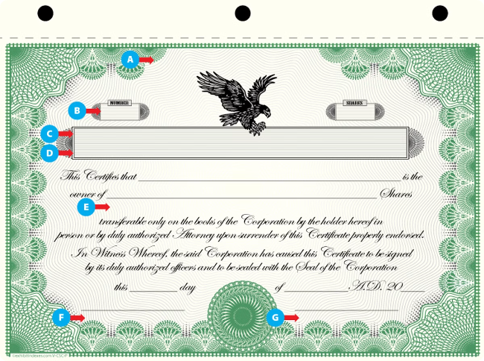



Stock Dividend Policy
A stock dividend policy involves distributing additional shares of company stock to existing shareholders instead of cash.
No Cash Outflow
No immediate cash outlay for the company, allowing for reinvestment of profits.
Share Dilution
Increase in the number of outstanding shares, potentially reducing the value per share.
Signal of Confidence
Can signal to investors that the company is confident in its future prospects.

Slide 8

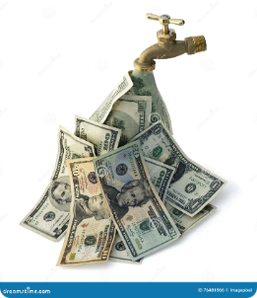



Cash Dividend Policy
A cash dividend policy involves distributing a portion of company profits to shareholders in the form of cash payments.
Direct Income
Shareholder Value
Company Performance
Provides shareholders with immediate cash flow, which they can use as they see fit.
Regular cash dividends can enhance shareholder value and attract investors seeking stable income.
Cash dividends signal the company's financial health and ability to generate sustainable profits.

Slide 9
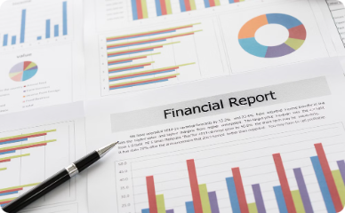

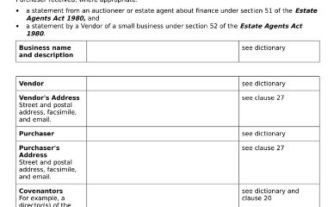

Factors Influencing Dividend Policy
Several factors influence a company's dividend policy, including financial health, growth prospects, legal constraints, and shareholder expectations.
Financial Performance
Investment Opportunities
Debt Obligations
Shareholder Preferences
Companies with strong earnings and cash flow are better positioned to pay dividends.
Companies with high debt levels may be restricted from paying dividends.
Companies may prioritize reinvesting profits into growth projects over paying dividends.
Companies may consider the dividend expectations of their investor base.

Slide 10


Conclusion
Dividend policy is a vital aspect of corporate finance that significantly impacts shareholder returns and company value. Companies must carefully consider factors influencing their dividend policy to maximize shareholder value while ensuring sustainable growth.

